Slide 1
GDPR – Data Portability
The PIMS approach

Slide 2
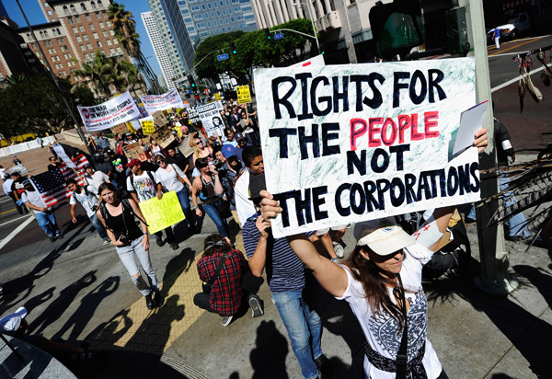
Le cas des données Auchan via Onecub pour Umanlife
De quelle manière les données portables doivent-elles être fournies ?

Slide 3
RGPD – Article 20
Droit à la Portabilité des Données
What is Data Portability?

Slide 4
Le cas des données Auchan via Onecub pour Umanlife

Slide 5
I want to travel to London
I got
the flu

Slide 6
RGPD – Article 20
Droit à la Portabilité des Données
How could it work?

Slide 7
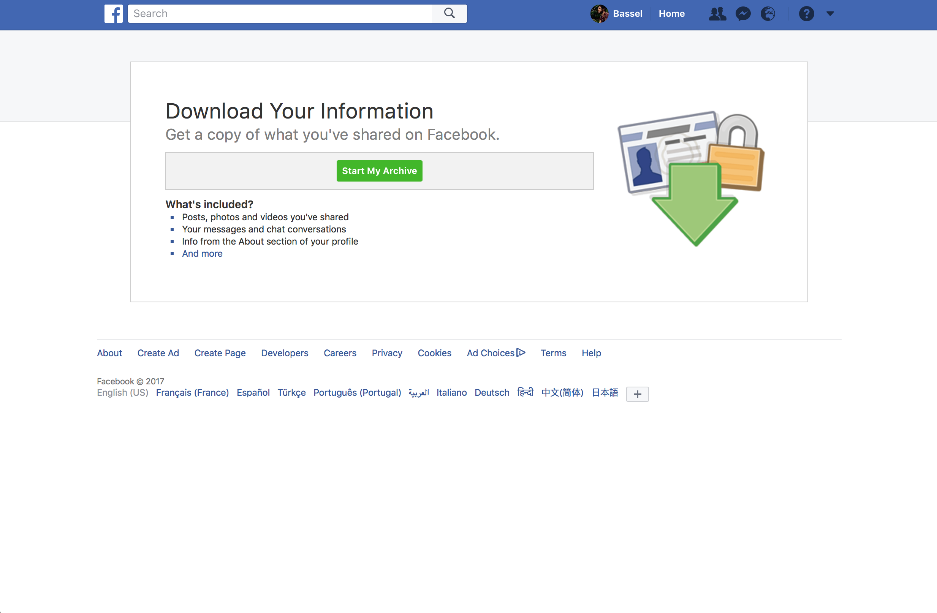
Solution 1
Direct Personal Data download

Slide 8
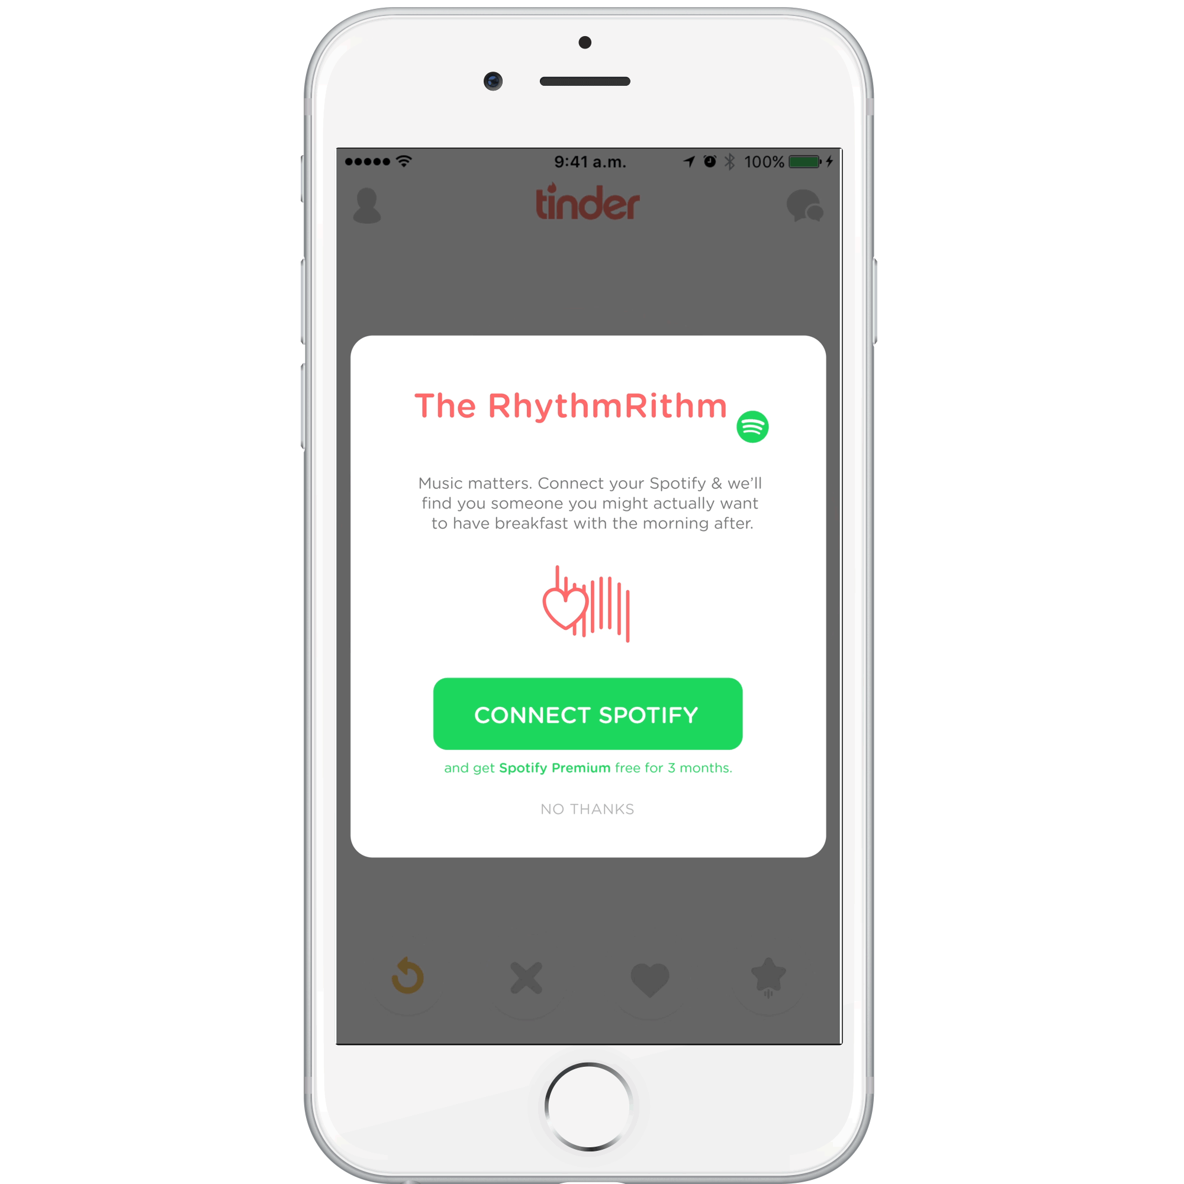
Solution 2
Direct transfert from one service to another

Slide 9
Solution 3
The PIMS Approach
‘The individual manages his/her data’
PIMS: Personal Information Management Systems
VRM: Vendor Relationship Management
PDS: Personal Data Store
SSID: Self Sovereign Identity
My Data

Slide 10
RGPD – Article 20
Droit à la Portabilité des Données
How could Data Portability look like for people?

Slide 11
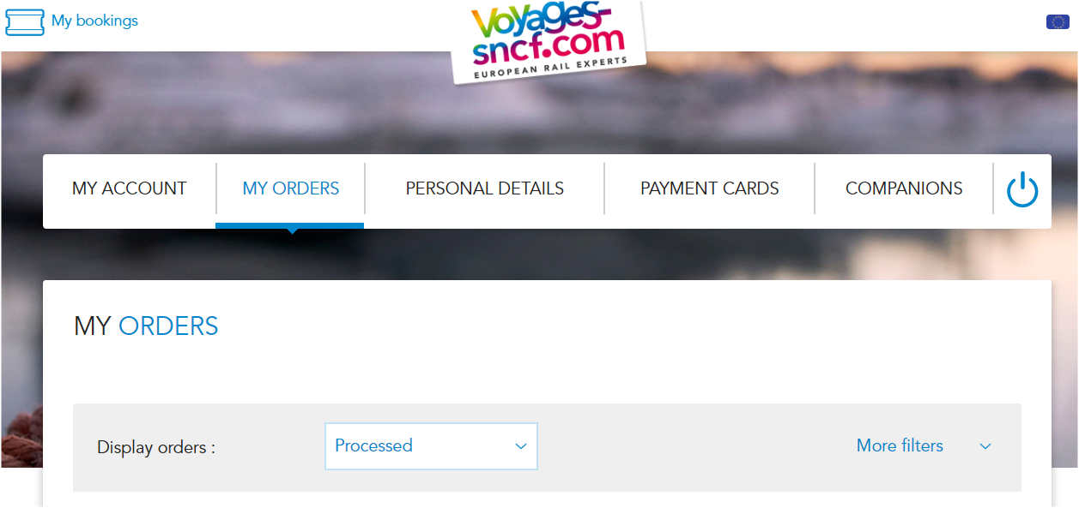
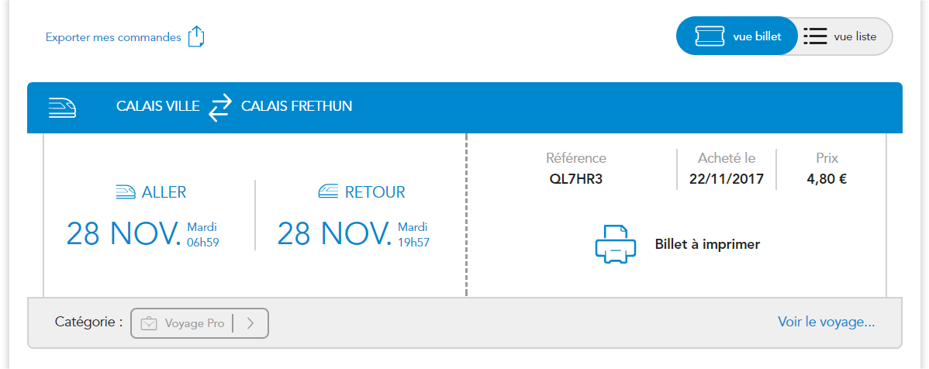
Le cas des données Auchan via Onecub pour Umanlife
Export my train tickets

Slide 12
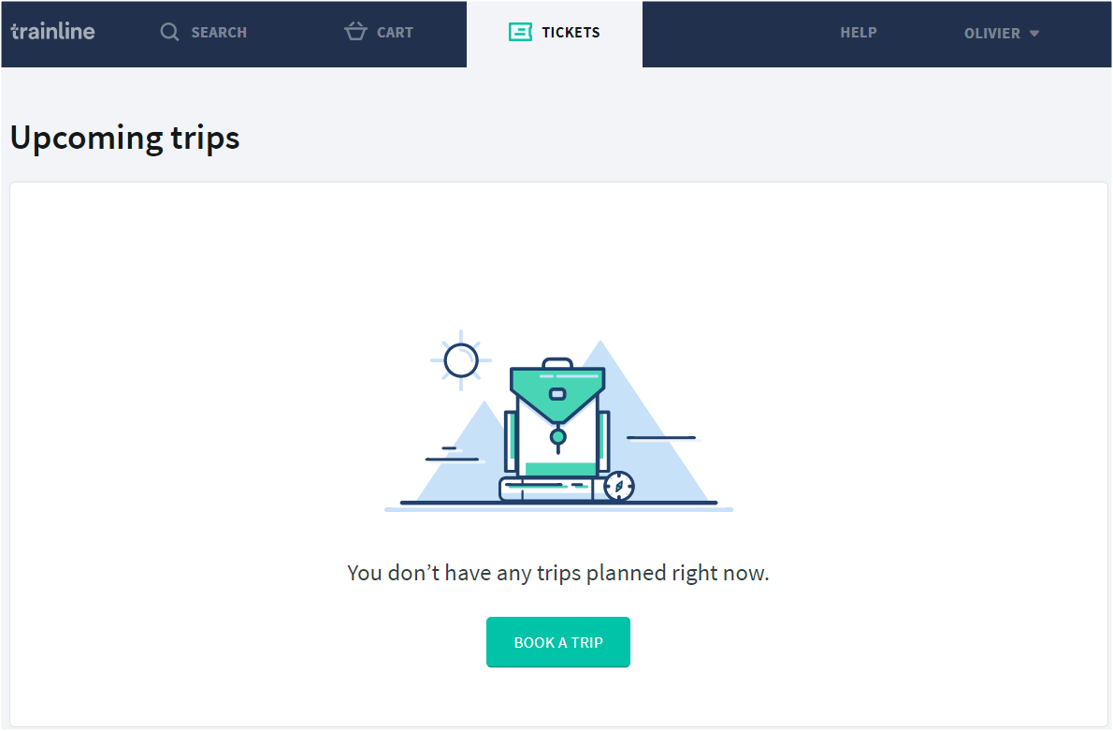
Le cas des données Auchan via Onecub pour Umanlife
IMPORT MY TICKETS

Slide 13
RGPD – Article 20
Droit à la Portabilité des Données
How does Onecub work?

Slide 14
A Data Portability tool
Le cas des données Auchan via Onecub pour Umanlife
Export
Import

Slide 15
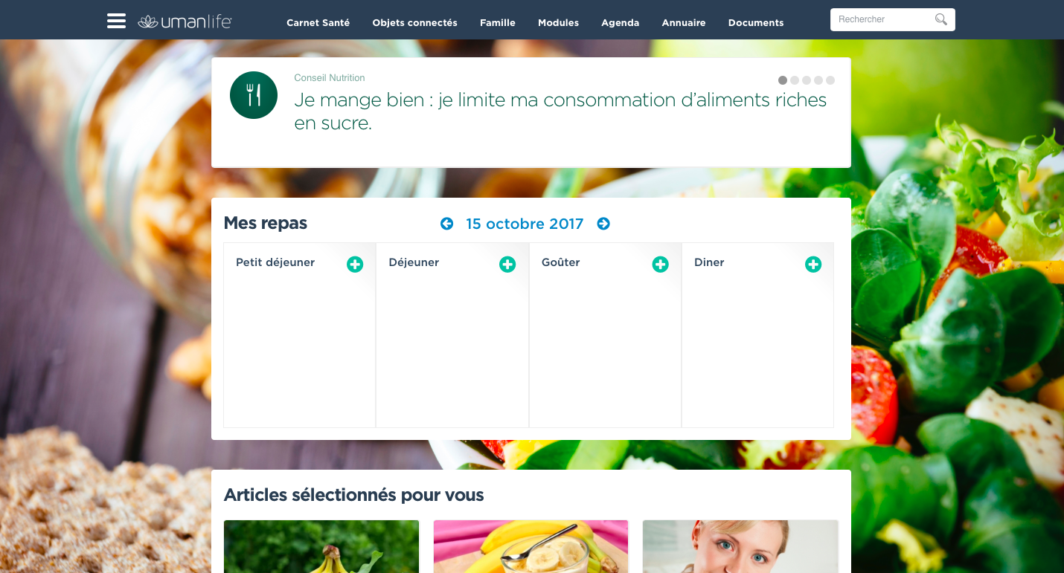
Do you want to automatically change your shopping lists in balanced recipes ?
1. I synchronize my shopping lists data with my Umanlife coach
2. My Umanlife coach suggests me some balanced recipes based on my last shopping list
3. In 1 click, I can add recipes to my food calendar or ask for new ones if I’m not satisfied
Import my food shopping lists data

Slide 16
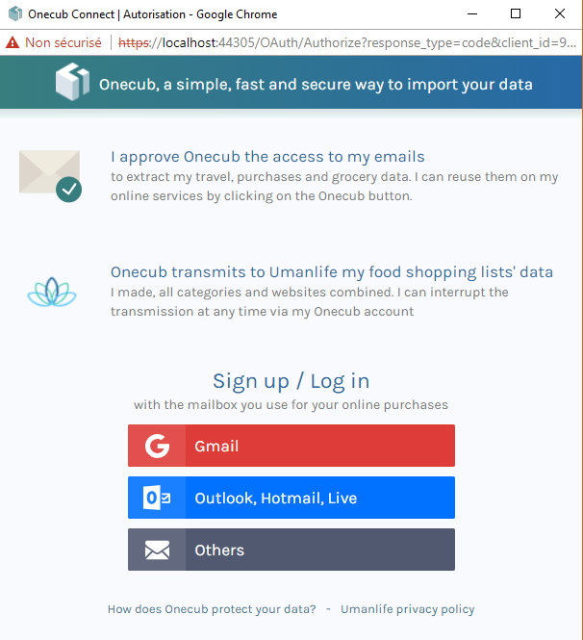
Do you want to automatically change your shopping list in balanced recipes ?
1. I synchronize my shopping lists data with my Umanlife coach
2. My Umanlife coach suggests me some balanced recipes based on my last shopping list
3. In 1 click, I can add recipes to my food calendar or ask for new ones if I’m not satisfied
Import my food shopping lists data

Slide 17
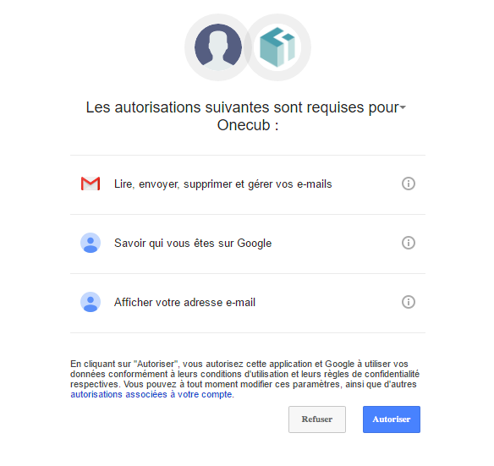
Do you want to automatically change your shopping list in balanced recipes ?
1. I synchronize my shopping lists data with my Umanlife coach
2. My Umanlife coach suggests me some balanced recipes based on my last shopping list
3. In 1 click, I can add recipes to my food calendar or ask for new ones if I’m not satisfied
Import my food shopping lists data

Slide 18
Do you want to automatically change your shopping list in balanced recipes ?
1. I synchronize my shopping lists data with my Umanlife coach
2. My Umanlife coach suggests me some balanced recipes based on my last shopping list
3. In 1 click, I can add recipes to my food calendar or ask for new ones if I’m not satisfied
Import my food shopping lists data
We are recovering your data and transferring its to Umanlife

Slide 19
Do you want to automatically change your shopping list in balanced recipes ?
My next food shopping lists will automatically be transferred to my Umanlife coach
I can manage my data sharings through my Onecub account
My food shopping lists data imported
150gr Muesli with yogurt
1 Banana
1 apple
Thai pumpkin soup
1 apple compote
100gr Asian quinoa salad with ginger
Lentils with pork
1 pear

Slide 20
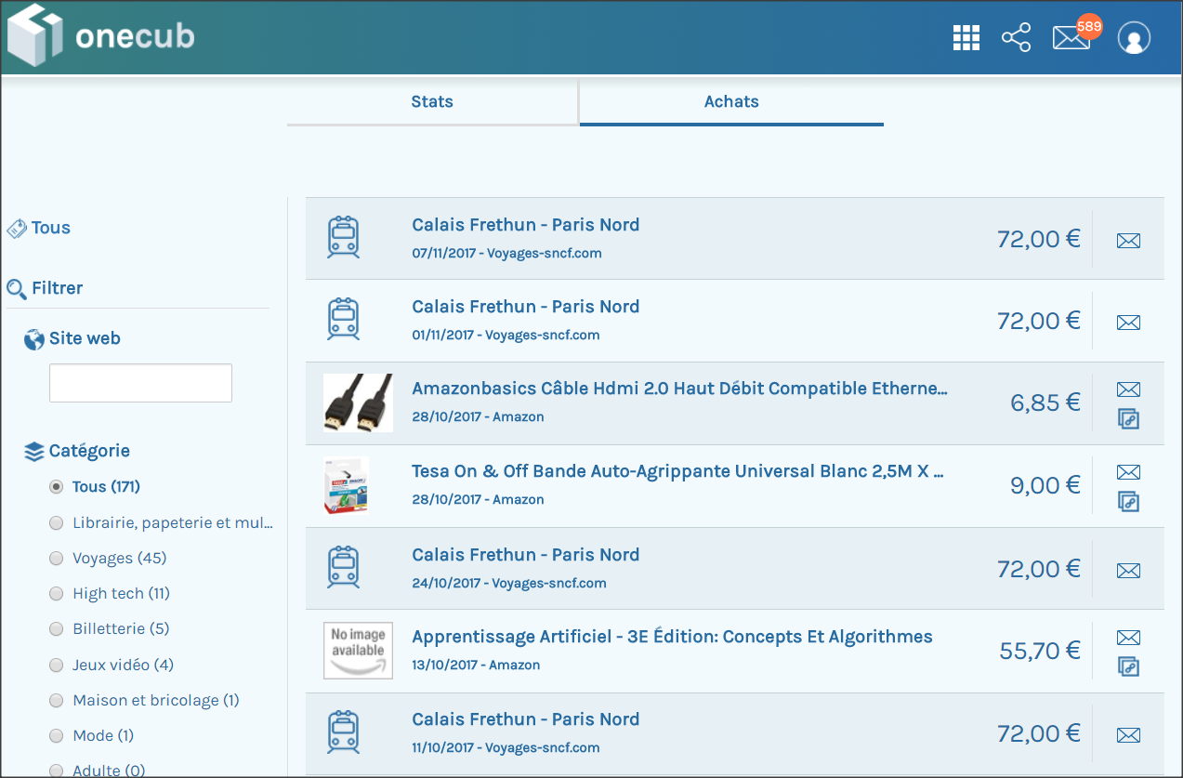

Slide 21
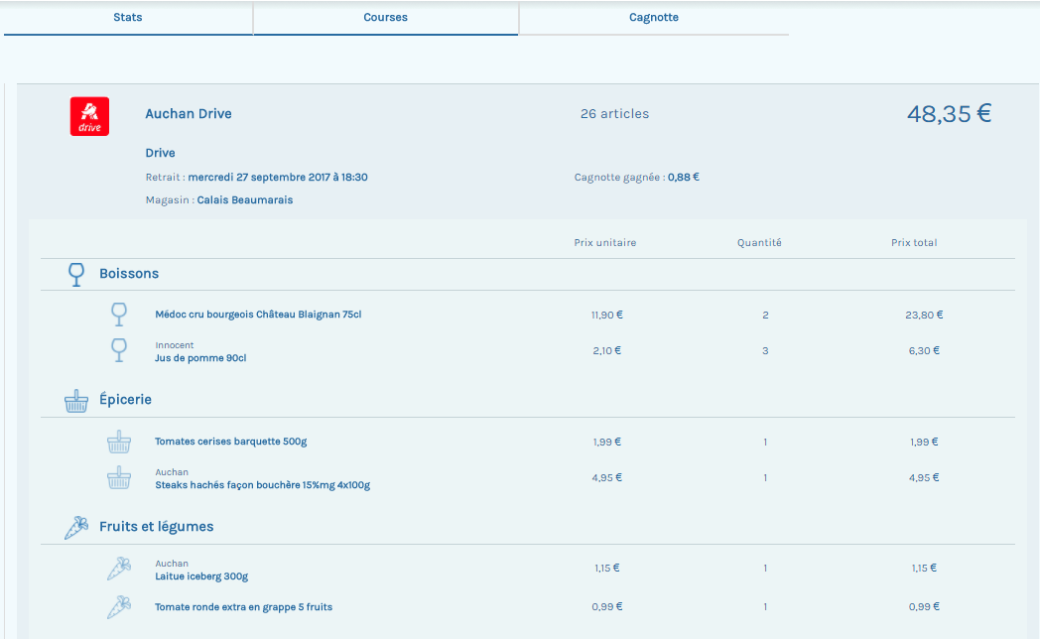

Slide 22
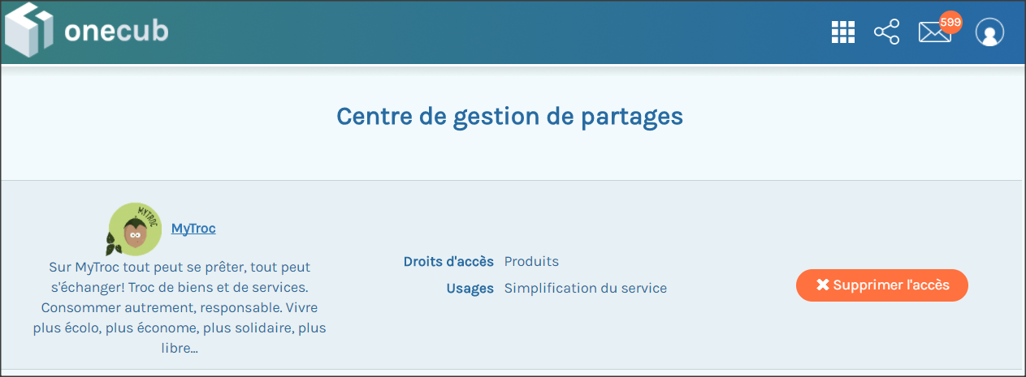

Slide 23
RGPD – Article 20
Droit à la Portabilité des Données
What can I do with my data?

Slide 24
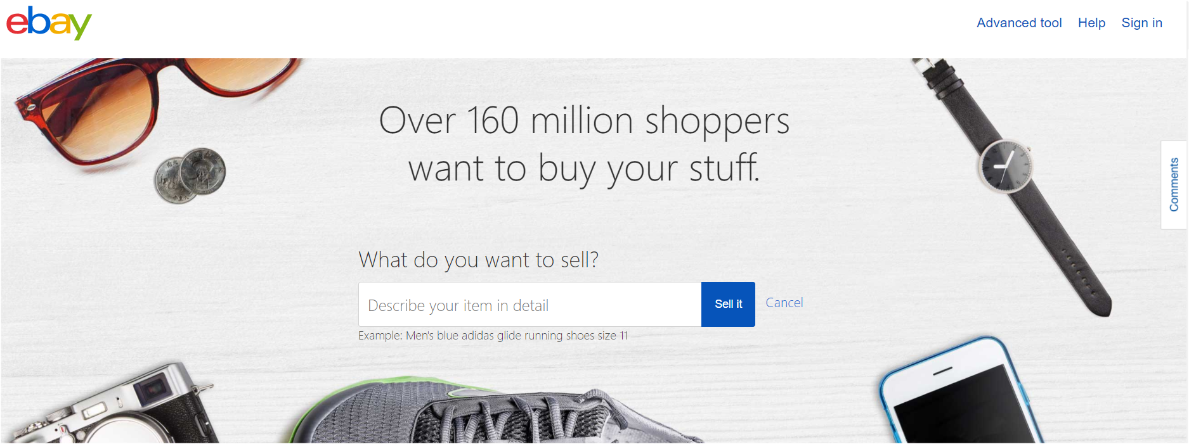
« I want to resell my goods »
Or
Import your E-commerce purchase Data

Slide 25
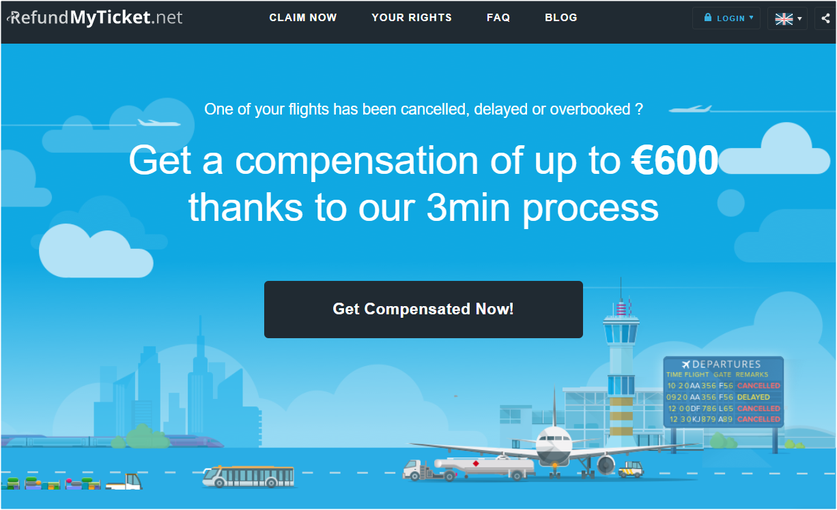
« I want compensation when my plane is delayed »
Import my plane tickets

Slide 26
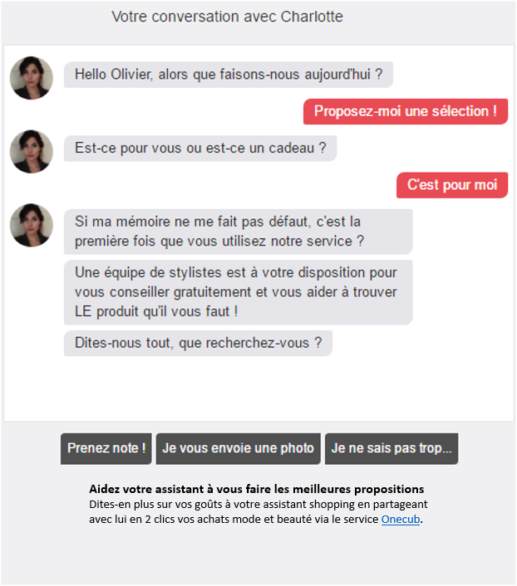
« I want advice about clothing »
Chat with your virtual stylist
Hello Olivier, may I help you?
Show me a selection!
Is it a gift or is it for you?
This is for me!
First time you use the service?
Do not worry, our team will give you the best advice. We will find the best outfit for you.
What are you looking for?
I will tell you!
I take a picture
I don’t know…
Share my digital wardrobe with my stylist
IMPORT MY CLOTHING PURCHASES

Slide 27
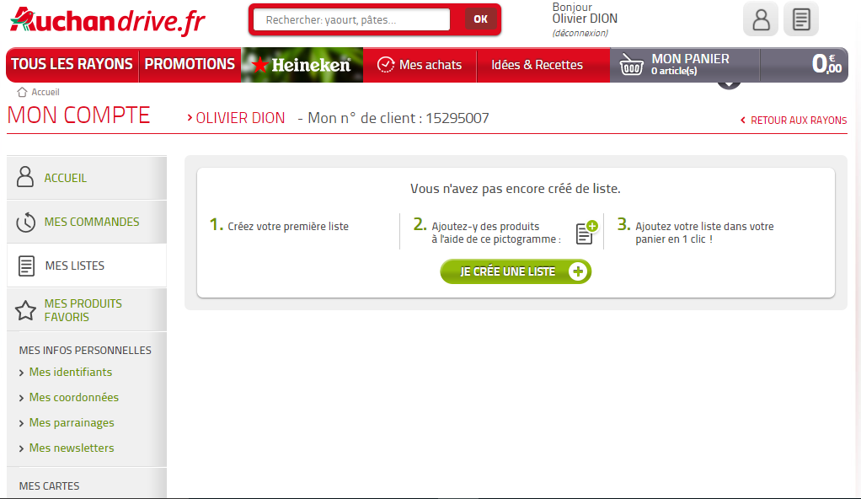
« I want to shop faster »
Importez vos listes de courses effectuées sur vos autres sites de Drive et de courses en ligne en quelques clics via le tiers de confiance Onecub.
IMPORTER MES LISTES

Slide 28
RGPD – Article 20
Droit à la Portabilité des Données
Could we talk the same language?

Slide 29
Dairy products
Fresh food

Slide 30
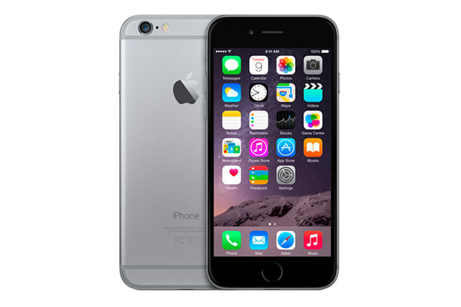
Apple iPhone 6 Smartphone
unlocked 4G (4.7 inches –
16 Go - iOS 8) Grey
iPhone 6 - 16Go Grey

Slide 31
RGPD – Article 20
Droit à la Portabilité des Données
What about GAFA and Data Portability?

Slide 33
RGPD – Article 20
Droit à la Portabilité des Données
A global architecture for Data Portability?

Slide 34
Decentralizing personal data
Open
Reference
Databases
An Identity Blockchain
My PIMS
‘Olivier’ ‘bought’ ‘Harry Potter on Amazon’
‘Olivier’ ‘took’ ‘a train to London’

Slide 35
Contact us
www.onecub.com
olivier@onecub.fr
+33.6.73.42.80.18
Olivier
Founder & CEO
55 boulevard Vincent Auriol, 75013 Paris
@onecub
Onecub
Onecub

